Slide 1





Density modification in crystallography and cryo-EM
Phenix Workshop
IUCr Congress, Melbourne
22 September, 2023
Tom Terwilliger
Los Alamos National Laboratory/New Mexico Consortium
Notes:
Many methods for map improvement in X-ray and Cryo-EM
An important one is density modification. This short talk and the tutorial we will run after it will illustrate the similarity of X-ray and Cryo-EM density modification and show you how to use it for Cryo-EM.

Slide 2
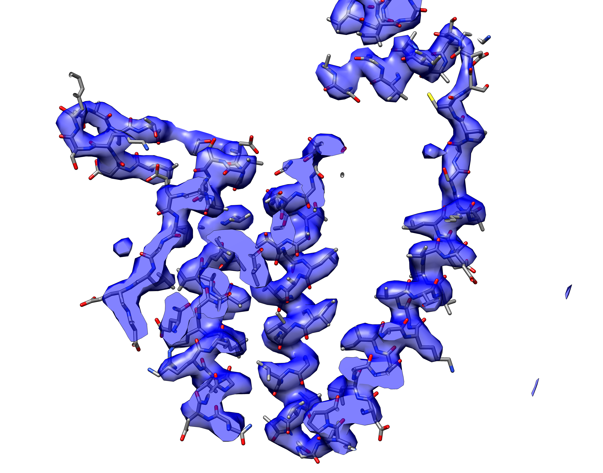
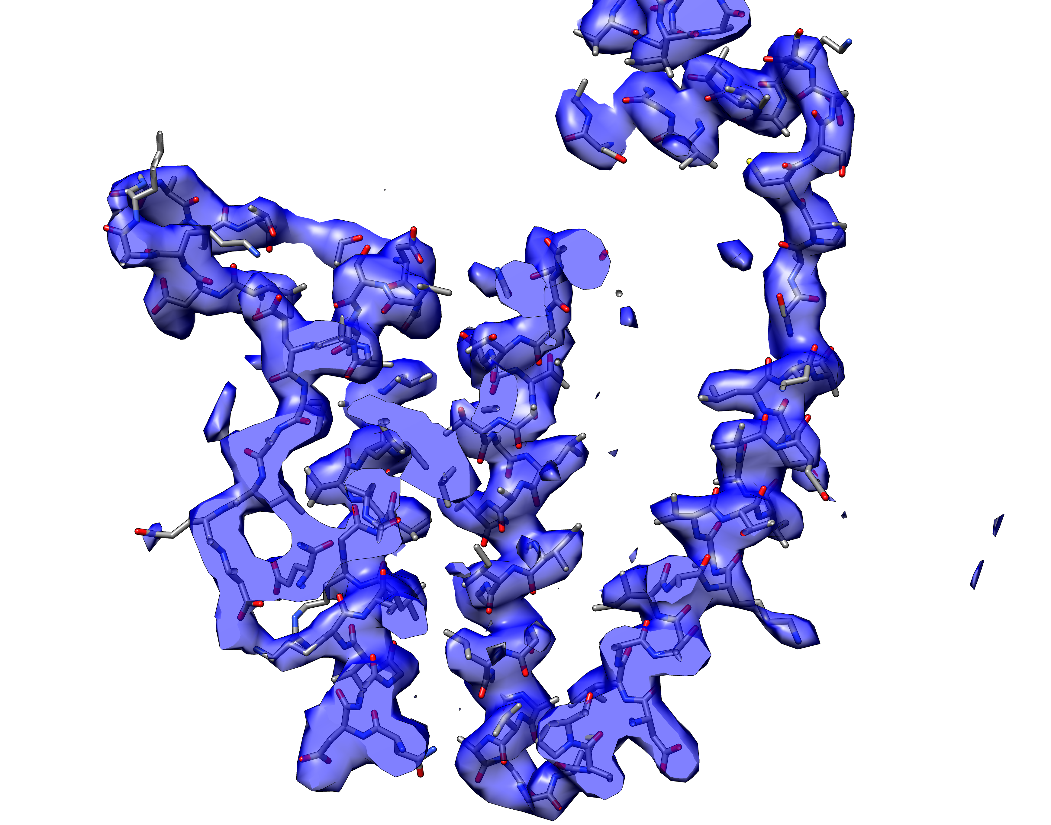
Crystallographic and cryo-EM maps are similar in many ways
X-ray map
(3.8 Å resolution)
Cryo-EM map
(3.5 Å resolution)
GroEL residues 10-170
Notes:
A Experimental X-ray map (MIR phasing, density modified) at resolution of 3.8Å of groEL showing residues 10-170 (masked around atoms in these residues).
B Experimental cryo-EM map at resolution of 3.5 Å of groEL showing residues 10-170 (masked around atoms in these residues).

Slide 3
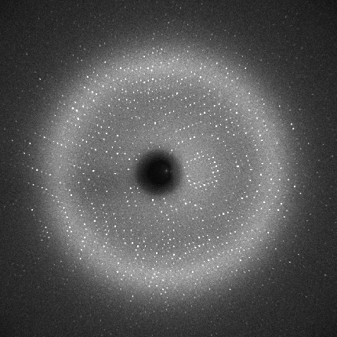
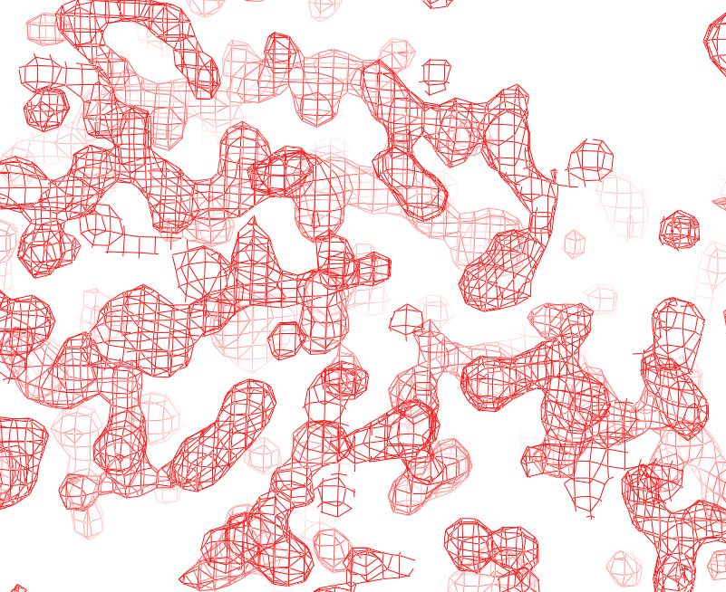
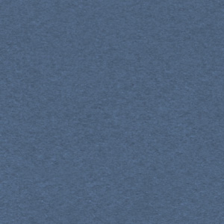
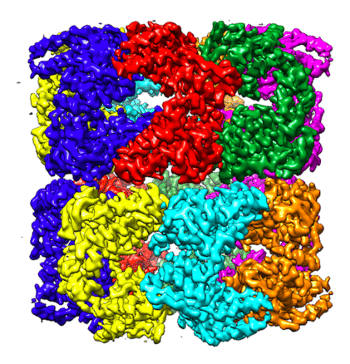
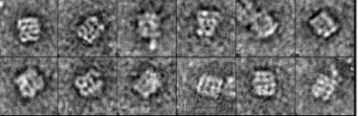
X-ray and cryo-EM maps as Fourier transforms
(X-ray data are missing phases)
X-ray
Combine FT sections
Inverse FT with phases
Diffraction pattern is (more or less) section through FT of structure (amplitudes only)
Combine FT sections
CryoEM
Inverse FT
FT of one image is a section through FT of structure (amplitudes and phases)

Slide 4
Density modification
What does a good density map look like?
Use expected features of maps to improve map quality
Key feature of this process: improving density anywhere can improve it everywhere*‡
*Works if errors are local in Fourier space ‡Does not work if errors are local in real space
Terwilliger et al. (2020) Acta Cryst. D76, 912-925.
Notes:
NEXT: Careful scaling of SAD data is important….

Slide 5
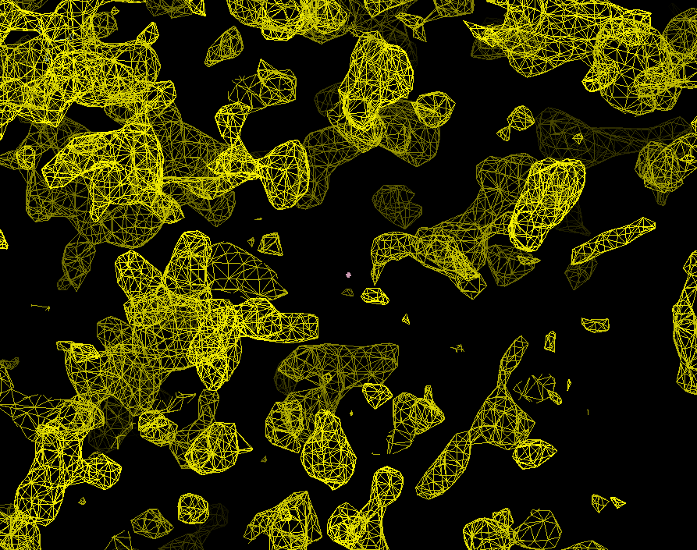
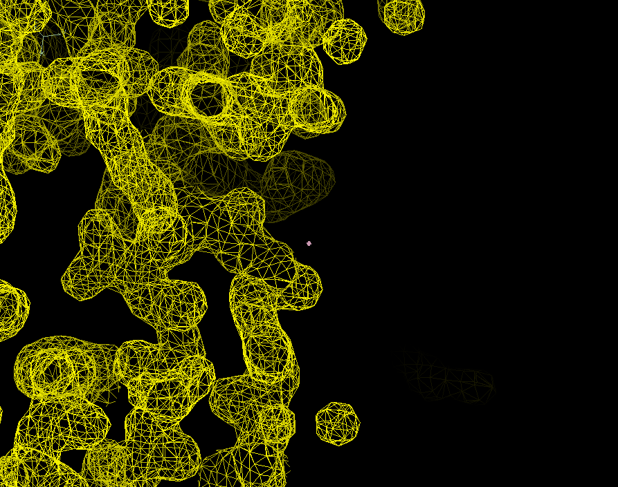
Map evaluation and improvement
Which map is better?
Density looks like protein
Flat solvent region
Connected density
Not shown:
NCS-related density looks similar
Histograms of density match expected distributions

Slide 6
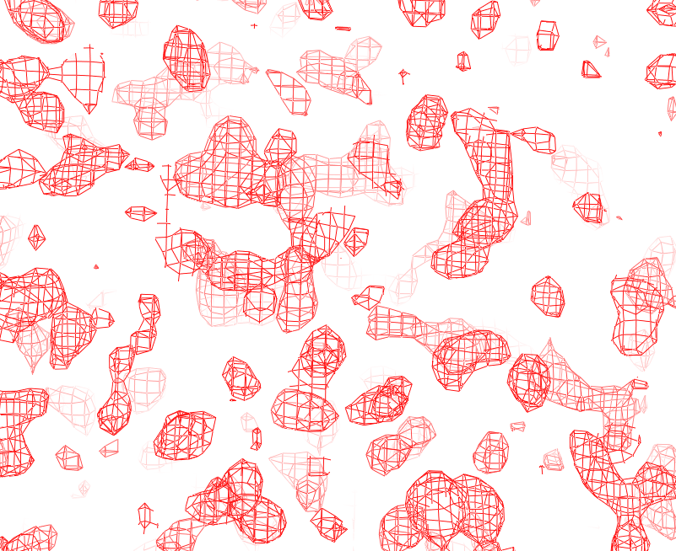
X-ray density modification: “phase improvement”
Experimental Data
Initial phases
Improved phases
Noisy Map
Clear Map
Notes:
With the same data, *poor phases lead to a *noisy map and *good phases give a *clear map.
Density modification is improving the phases to obtain a clear map. *

Slide 7
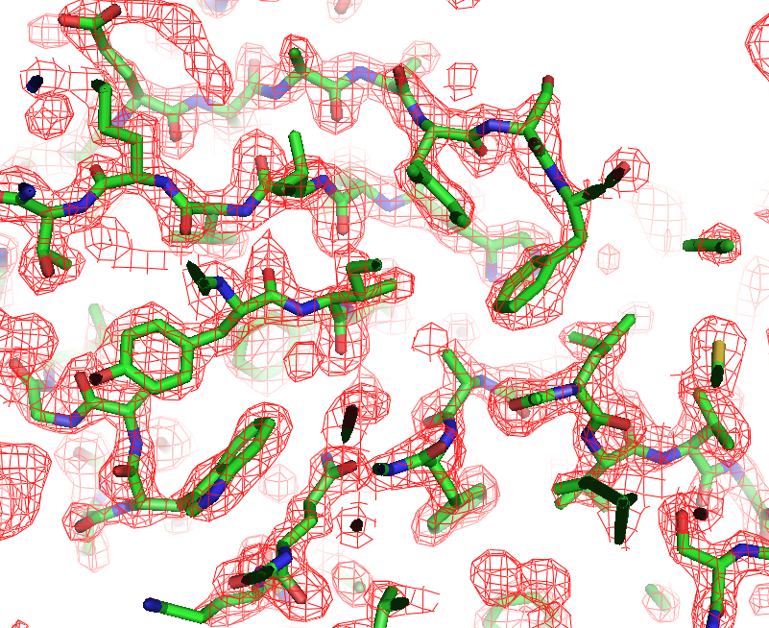
We know a good map when we see it
Noisy map
Clear map
Notes:
Look at these two maps. The on the left is noisy and the one on the right is clear.
We can list things that are different in the clear map:
*A flat solvent region. This region is featureless because the water molecules in the crystal are in different places in each unit cell and we just see the average.
*Good connectivity.
Clear density that looks like a protein. *

Slide 8
Basis of density modification
Noisy map
Clear map
2. Improvement anywhere improves the phases so there is improvement everywhere
1. We know a good map when we see it
Notes:
We are going to improve the noisy map to create the clear map using two key facts:
First, we know what a good map looks like.
Second, and most importantly, if we can IMPROVE THE PHASES by improving the map anywhere, we automatically improve the map everywhere. *

Slide 9
Density modification
Identify local expected density
Find phases consistent with experiment and expected density
Noisy map
Clear map
Density everywhere is improved
Expected density can include…
Flat solvent
Connectivity
Density matches model
Histogram matching
NCS
Expected shapes
Notes:
Here is our strategy:
Identify places in the noisy map where we know how to improve the density. We might be pretty sure that the density in the upper
* right is flat. Now we can ask a question like:
* What phases that are consistent with our experimental measurements would lead to flat density in the upper right?
* Those phases can lead to a map that is better everywhere. So now…how do we do this in practice? We are going to see how this is done in the procedure known as “statistical” or “maximum-likelihood” density modification. *
(Note the process has a few more steps, but this is the essence of it. To get the map on the right we actually used two characteristics of the map: flatness of solvent and distribution of density in the protein region, and the phase improvement process was iterated many times.)

Slide 10
One-dimensional example:
One atom and a flat solvent region
Protein atom
Flat solvent
Notes:
Let’s look at a 1-dimensional example that has all the details of statistical density modification
Let’s imagine a crystal with one protein atom (the * peak in this 1-D curve)
and a flat solvent (the * flat part of the curve) *

Slide 11
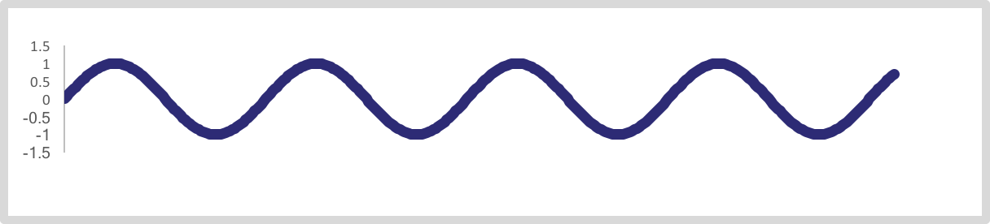
A Fourier sum of sines and cosines
Protein atom
Flat solvent
Fourier terms
sum to make the curve
Notes:
Now let’s think of this curve as a Fourier sum of sines and cosines. Just like crystallography where the map is a sum of Fourier terms.

Slide 12
“Map phasing”: key to density modification
Find out the phase of one Fourier term using:
1) All other Fourier terms
Protein atom
Flat solvent
2) Flat solvent
Notes:
We are going to figure out the *phase of one Fourier term given two things: One: the * phases of all the other Fourier terms, and Two: our expectation that the * solvent is flat. *

Slide 13
“Map phasing”
Protein atom
Flat solvent
Take out one Fourier term:
Notes:
Let’s take * out one Fourier term from our curve. This will make a ripple in the map.
Notice that the solvent now has a * ripple in it.
and that the * protein atom is distorted.

Slide 14
Using flat solvent to identify phase of one term
One Fourier term:
Correct phase
Phase 180º off
Adding the incorrect phase
Adding the correct phase
Solvent gets worse
Notes:
Now we are going to figure out the phase of the Fourier term we took out.
We are going to notice what the solvent looks like when we add the term back with each possible phase.
Let’s start with the * poor map with a ripple.
If we add the Fourier term back in with the *correct phase the *solvent region becomes flat. The Fourier term cancels the ripple.
Notice that the protein region is now * perfect again.
If we add the Fourier term back in with the * wrong phase,
the solvent region becomes even *more rippled.
Now comparing the maps with the two possible phases, and only looking in the region of the solvent, it is obvious which is correct. *
We have just accomplished two things:
We have used our expectation about the * flatness of the solvent to
identify the * phase of this one Fourier term
and this has * improved the map in the protein region. We have just transferred information from one part of the map to another.

Slide 15
Density modification of real maps
Starting map and expectations about map ➔ phase probabilities (“map phasing”): p_{map}(φ)
Experimental phase information may be available: p_{exp}(φ)
Density modified phase probability combines experimental and map phasing probabilities:
p(φ) = p_{exp}(φ) p_{map}(φ)
Incorrect phase
Correct phase
Notes:
In the *real world…we don’t know the phases of the other Fourier terms exactly. Instead of getting a single correct phase, we get map-based probabilities for each possible phase. We have * experimental phase information as well
We can *combine these to get our density modification phase probability for this one Fourier term *

Slide 16
Key elements of X-ray density modification
Improved phases
p(φ) = p_{exp}(φ) p_{map}(φ)
Improvement anywhere means improvement everywhere
Density modification transfers information from one part of the map to another
We know a good map when we see it
Notes:
Finally we use our new phase information to calculate a map.
To summarize the key points:
We * know what a good map looks like. If we can *improve the phases by improving the map anywhere, we automatically improve the map everywhere.
* Density modification transfers information from one part of the map to another *

Slide 17
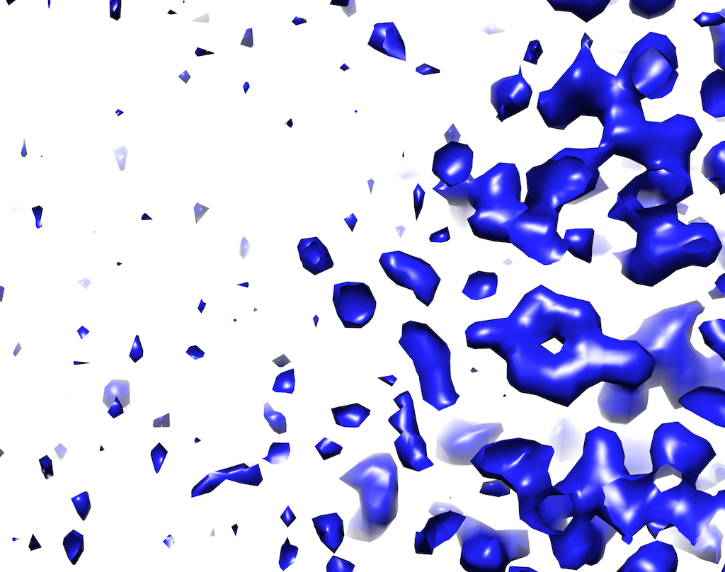
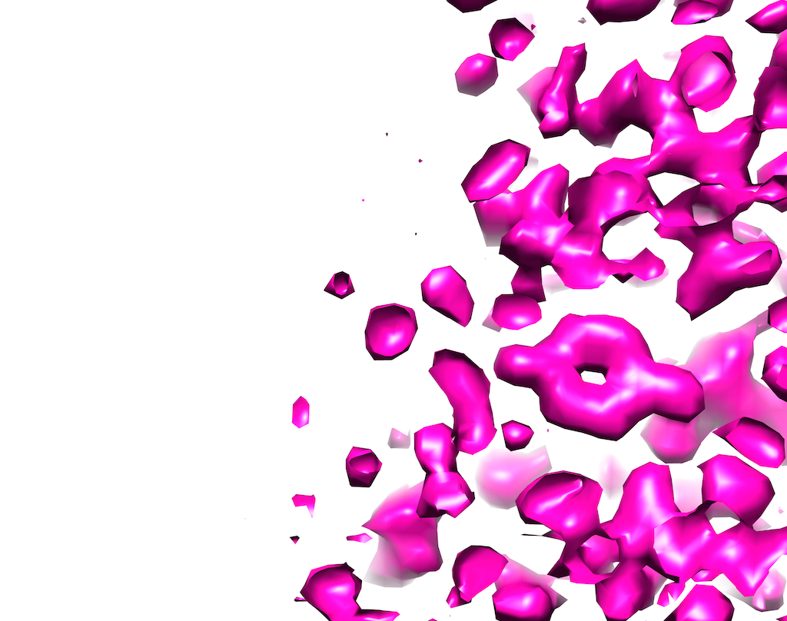
Density modification with cryo-EM maps
Original map
Density-modified
Flat solvent
Distribution of density values (histograms) should match typical protein
Similarity of copies
Shape looks like protein
Notes:
The original map is implausible because it has a noisy solvent and density profile is unlike that of typical protein.
The density-modified map is more plausible with flat solvent and density histograms similar those of typical protein

Slide 18
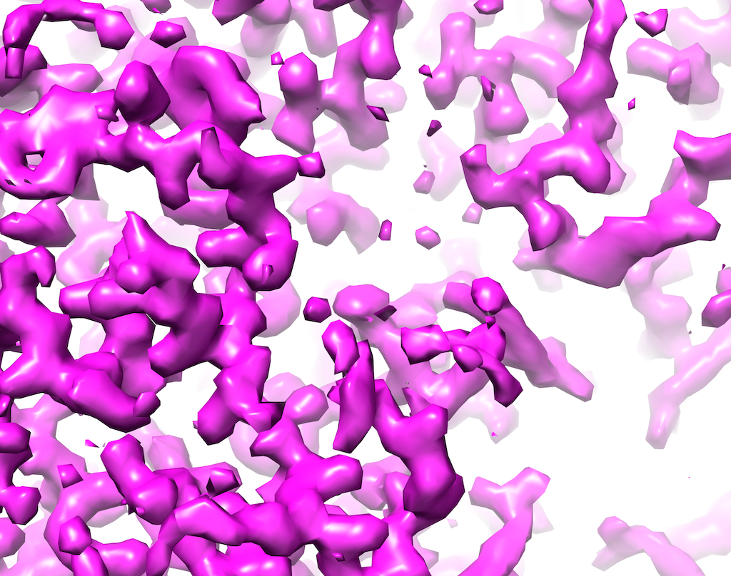
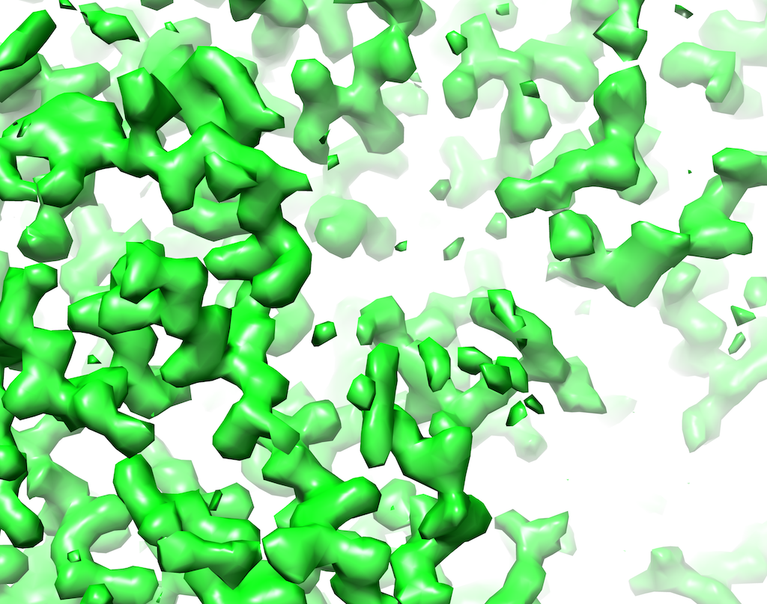
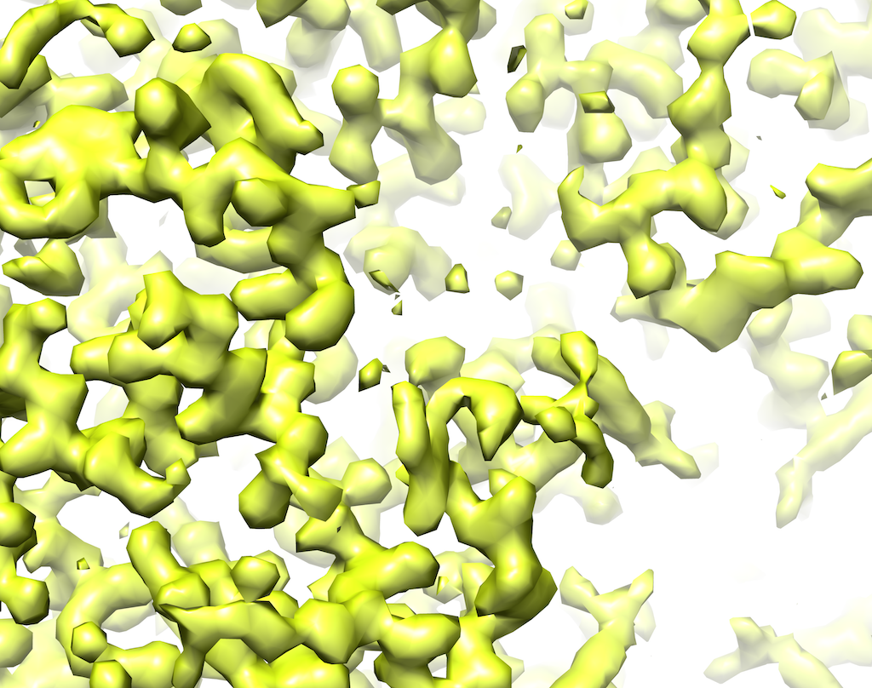
Density modification with cryo-EM maps
Sharpen/average to create full map
Identify macromolecule and solvent regions
Target histograms for macromolecule and solvent
Two half-maps
Fourier terms for two original half-maps
Map-phasing estimates of Fourier terms
(one set for each half-map)
Calculate weighted average of two original and two map-phasing sets of Fourier terms
6. Density-modified map
Notes:
Flow chart of density modification. Operations in real-space are in blue and those in reciprocal-space are in green.
Note that recombination is different in cryo-EM from crystallography because the starting errors have a different form

Slide 19
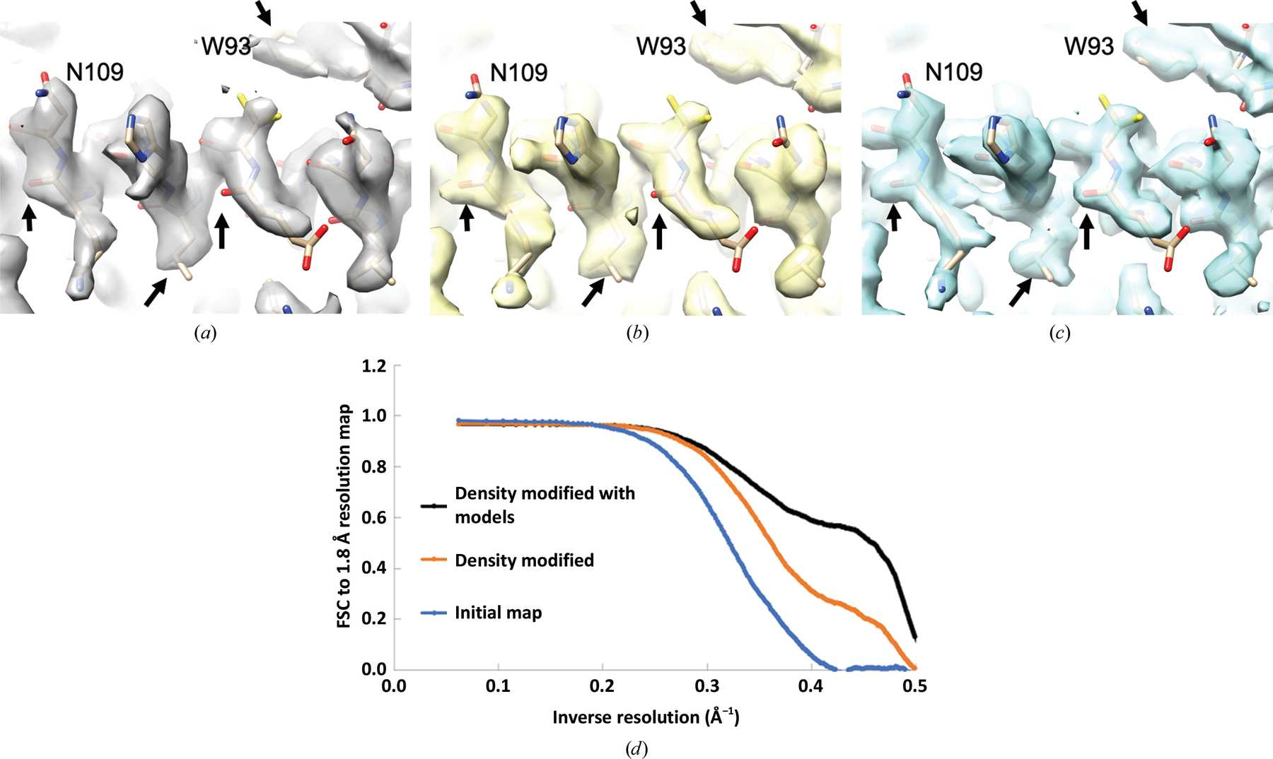
Density modification with cryo-EM maps
3.1 Å apoferritin map
Density modified
Density modified with ensemble of autobuilt models
Fourier shell correlation to high-resolution
(1.8 Å) apoferritin map
Terwilliger et al. (2020) Acta Cryst. D76, 912-925.
Notes:
3

Slide 20
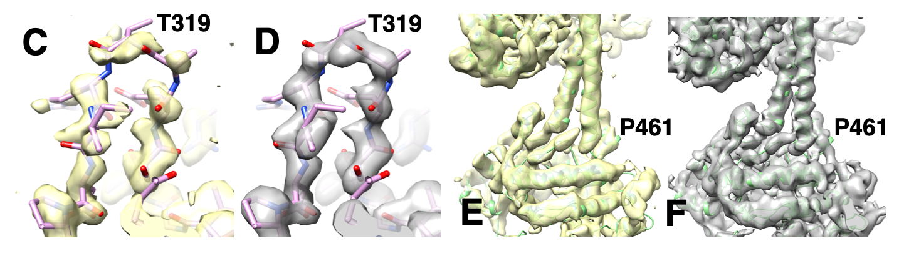
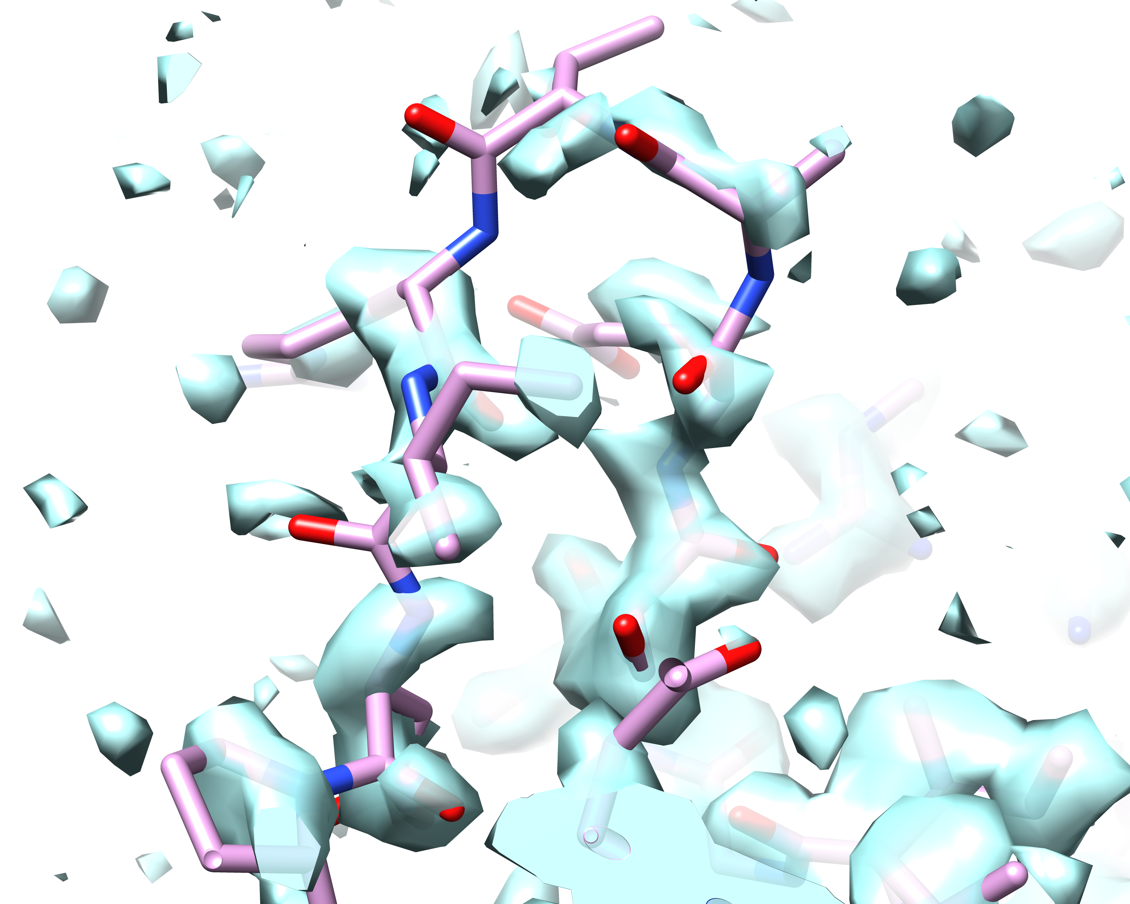
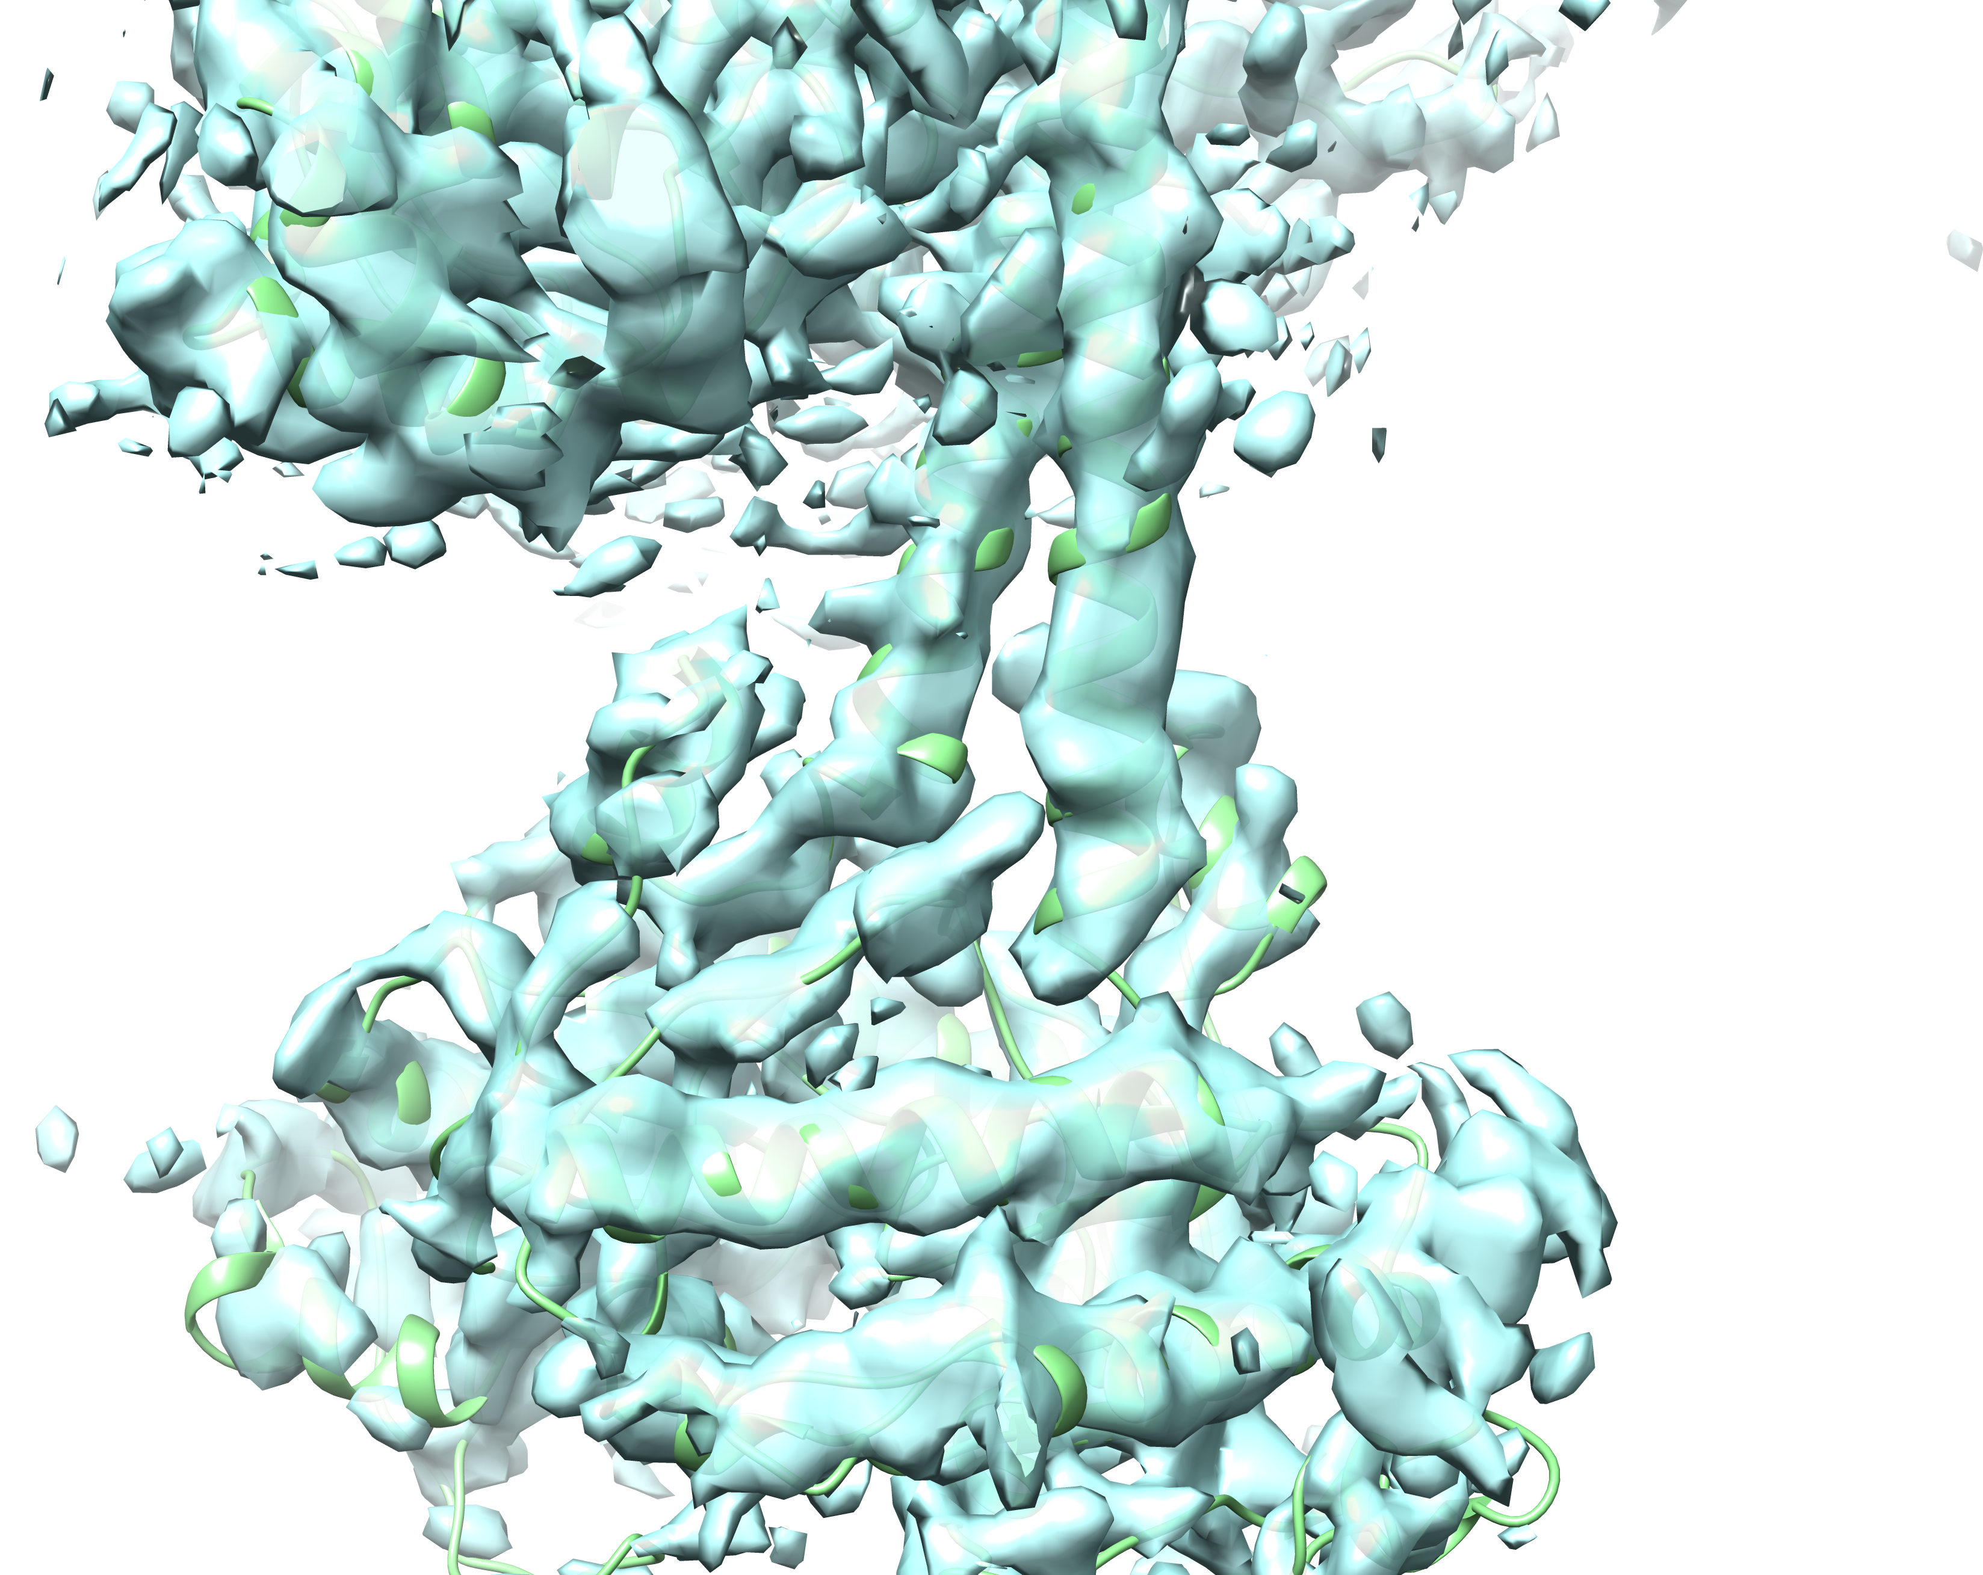
Density modification vs sharpening
Density modified
Density modified
Original
Original
Sharpened
Sharpened
Terwilliger et al. (2020) Acta Cryst. D76, 912-925.
Notes:
Fig. 2C,D
Figs. 2C and 2D show a loop region (residues A793-A804) that is poorly resolved in the β-galactosidase map at a resolution of 2.2 Å (EMDB entry 2984²⁷; PDB entry 5a1a; Fig. 2C and Supplementary Fig. 1A), but is clear in the density-modified map (Fig. 2D).
Figs. 2E and 2F show a 5.8 Å cryo-EM map of a guanylate cyclase²⁸ (EMDB entry 20282, PDB entry 6pas).

Slide 21
Cryo-EM density modification vs sharpening
Density modified
Density modified
Original
Original
Sharpened
Sharpened
Terwilliger et al. (2020) Acta Cryst. D76, 912-925.
Notes:
Fig. 2C,D
Figs. 2C and 2D show a loop region (residues A793-A804) that is poorly resolved in the β-galactosidase map at a resolution of 2.2 Å (EMDB entry 2984²⁷; PDB entry 5a1a; Fig. 2C and Supplementary Fig. 1A), but is clear in the density-modified map (Fig. 2D).
Figs. 2E and 2F show a 5.8 Å cryo-EM map of a guanylate cyclase²⁸ (EMDB entry 20282, PDB entry 6pas).

Slide 22





The Project
Lawrence Berkeley Laboratory
Los Alamos National Laboratory
New Mexico Consortium
Paul Adams, Pavel Afonine, Dorothee Liebschner, Nigel Moriarty, Billy Poon,
Oleg Sobolev,
Christopher Schlicksup
Tom Terwilliger, Li-Wei Hung
UTHealth
Matt Baker
University of Cambridge
Randy Read, Airlie McCoy,
Alisia Fadini
Duke University
Jane Richardson, Vincent Chen, Michael Prisant, Christopher Williams,
An NIH/NIGMS funded Program Project
Liebschner D, et al., Macromolecular structure determination using X-rays, neutrons and electrons: recent developments in Phenix.
Acta Cryst. 2019 D75:861–877

